Slide 1
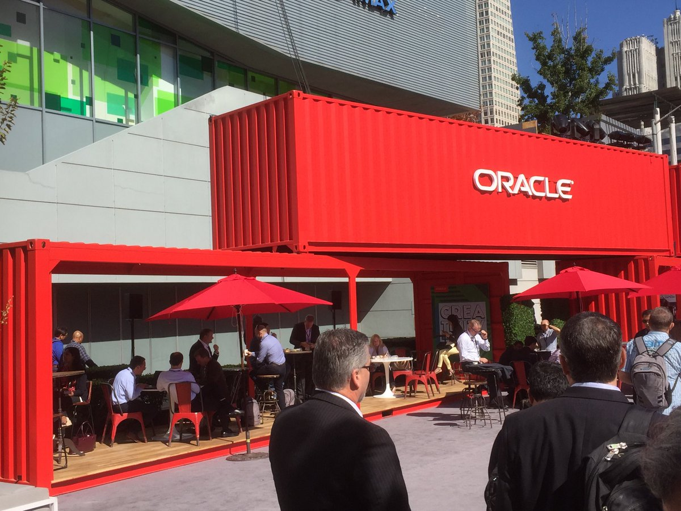

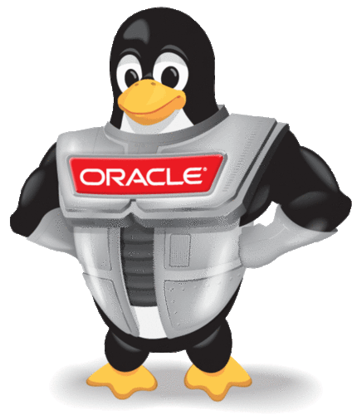
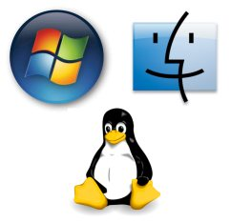
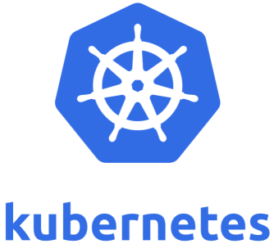
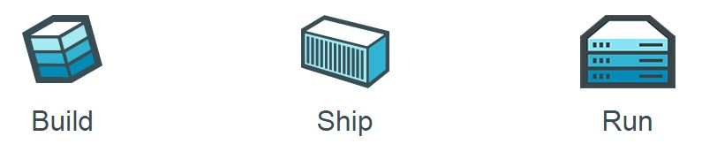
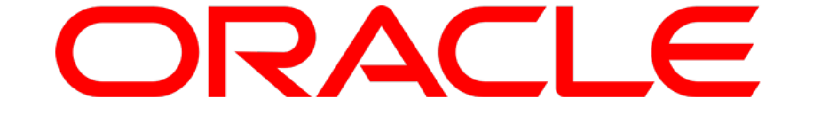
SIG Docker & Kubernetes
Automation
Run Time Flexibility
TCO
AMIS SIG – 15th July 2019
Eugène van der Voort & Lucas Jellema
Notes:
The microservices architecture promises flexibility, scalability, and optimal use of compute resources.
Via independent components with well-defined scope and responsibility, interface, and ownership that are evolved and managed in an automated DevOps process, this architecture leverages current technologies and hard-learned insights from past decades.
This session demonstrates how to implement, roll out, and manage a set of collaborating microservices on Oracle Cloud, using services such as
container (Docker) and Oracle Application Container Cloud,
event hubs, Oracle Container Engine (Kubernetes),
Oracle Identity Cloud Service,
Oracle Data Hub Cloud Service,
Wercker, Oracle Visual Builder Cloud Service, and Fn serverless platform
and open source tools: Istio, Prometheus, Zipkin, Grafana.

Slide 2
Overview
Scope, Context, Objectives
Introducing Docker Containers (aka VM++)
Light weight, quick start, standardize, distribute, automate, encapsulate
Demo
Oracle and Docker
Oracle products running on Docker & Oracle services around Docker
The search for a container management platform – to do for containers what application servers do for Java Enterprise Applications (and more)
Introducing: Kubernetes
Demo
Ecosystem (CNCF), Resources, Tooling, Roadmap
Oracle and Kubernetes
Workshop

Slide 3
What is IT all about?
Production Runtime
Application

Slide 4
What is IT all about?
Production Runtime
Application
Business value
Platform

Slide 5
Objectives
Business Agility
In functionality: quick, cheap, effortless and risk free
IT Agility
In non-functionality: scale, resilience, infrastructure & location
Real working applications with rapid relevant evolution that run reliably

Slide 6
What is IT all about?
Production Runtime
Operations
Monitoring & Management
Application
Platform
Platform
Platform

Slide 7
Production Runtime is the Result of Preparation Runtime
Preparation Runtime
Production Runtime
Development
Operations
Monitoring & Management
Application
Application
Agile Design, Build, Test
Platform
Platform
CD

Slide 8
One team has Agile responsibility through full lifecyle
Preparation Runtime
Production Runtime
Development
Operations
Monitoring & Management
Application
Application
Agile Design, Build, Test
Platform
Platform
CD

Slide 9
One team has Agile responsibility through full lifecyle
Preparation Runtime
Production Runtime
DevOps
Development
Operations
Monitoring & Management
Application
Application
Agile Design, Build, Test
Platform
Platform
CD
You build it, you run it, you fix it, you evolve

Slide 10
One team has Agile responsibility through full lifecyle
DevOps
Application
Application
Platform
Platform
You build it, you run it, you fix it, you evolve

Slide 11
Application
Dev
Application
Ops
Platform & Infra
Ops
Platform & Infra
Dev

Slide 12
Application
Dev
Application
Ops
Platform & Infra
Ops
Platform & Infra
Dev

Slide 13
Application
Dev
Application
Ops
Platform & Infra
Ops
Platform & Infra
Dev
Monitoring & Management
Agile Design, Build, Test

Slide 14
Functional requirements
Application
Dev
Application
Ops
Platform & Infra
Ops
Platform & Infra
Dev
Non Functional demands

Slide 15
Small, manageable, decoupled, stateless (horizontally scalable), “buy before build”
Functional requirements
Functional Monitoring & Tracing (APM), Health Checks
Application
Application
Platform & Infra
Platform & Infra
Deploy Frequently
Automated Pipeline, Canary, Regression Testing, Smoke Tests
Monitoring & Management
Agile Design, Build, Test
CD
Chaos Monkey
Automated Scalability, Distributed, Recoverable
Platform and Infra as Code: automated, version controlled
Test Less
Non Functional demands

Slide 16
DevOps team owns and runs one (or more) products
Application
Platform
Generic Infrastructure Platform for running DevOps Products
Floorspace, Power, Cooling, Storage, Compute
Monitoring, Management, Cache, Authentication, RDBMS, Event Hub

Slide 17
Multiple products from multiple teams run on a shared generic infrastructure
Application
Application
Application
Application
Application
Platform
Platform
Platform
Platform
Platform
Generic Infrastructure Platform for running DevOps Products
Floorspace, Power, Cooling, Storage, Compute
Monitoring, Management, Cache, Authentication, RDBMS, Event Hub

Slide 18
(Application plus platform)under DevOps ==
µ
µ
µ
µ
µ
Generic Infrastructure Platform for running DevOps Products
Microservice

Slide 19
Run & Operate Microservices
µ
µ
µ
µ
µ
Rapid rollout
Including scale out & recover
Non breaking upgrade & rollback strategies (e.g. canary release)
Agile infrastructure
Relocate, independent of infra specifics
Health management
Monitor and safeguard SLA requirements on response time, success and availability
Scale elastically
TCO management
DevOps: one team creates and runs
Generic Infrastructure Platform for running DevOps Products

Slide 20
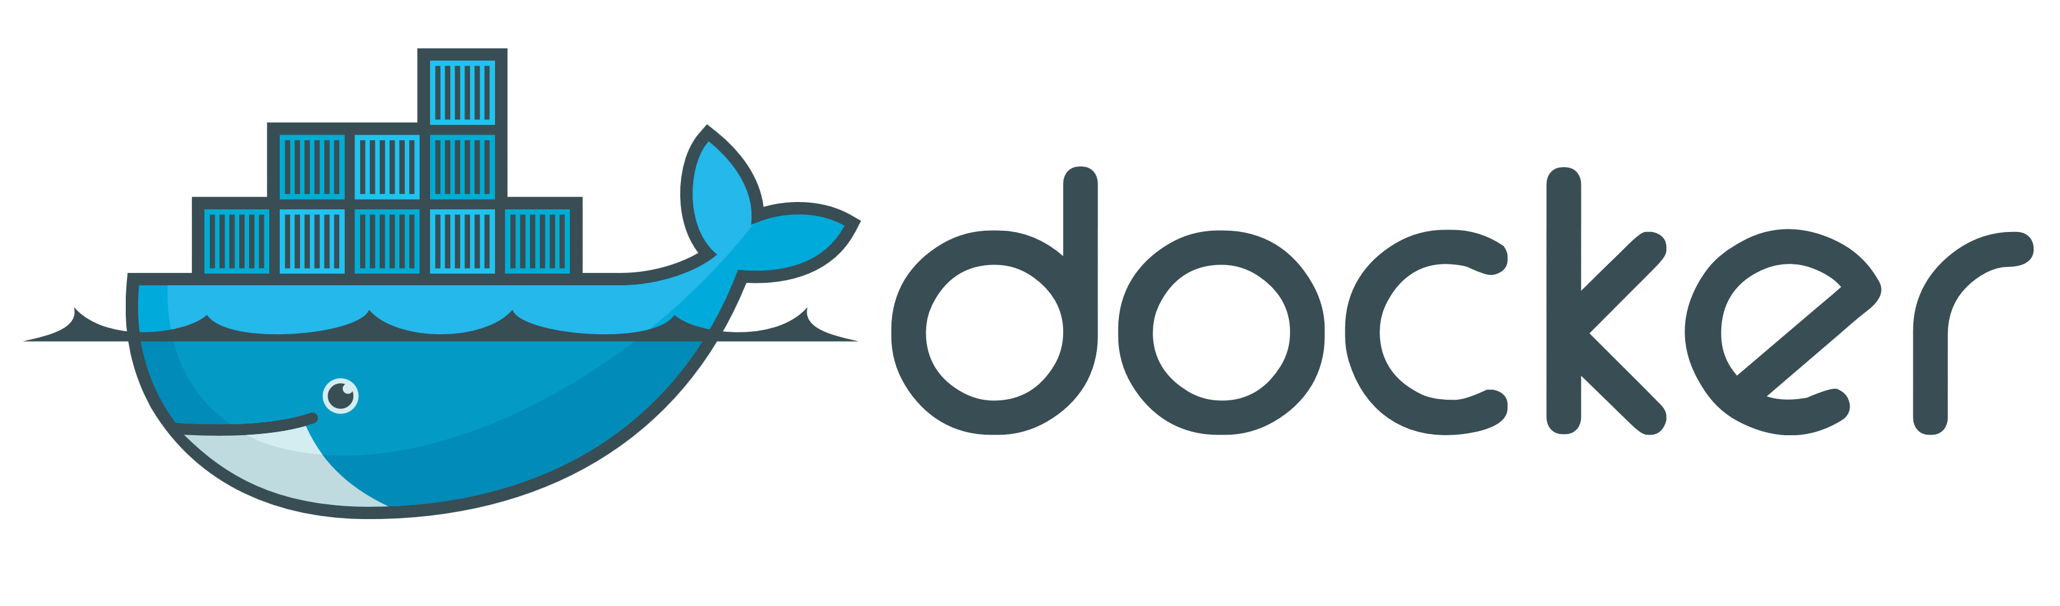


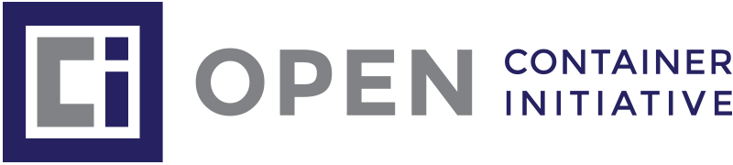
The elephant in the room…
whale

Slide 21
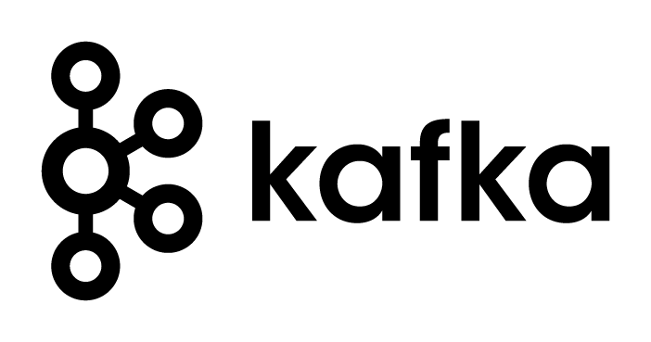
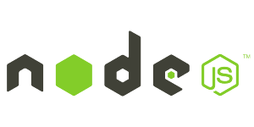
Setup for Oracle OpenWorld Demo What I needed
Local installation of a Kafka Cluster
At least one Broker node and the Zookeeper
Demo Application
Kafka Broker
Zookeeper

Slide 22
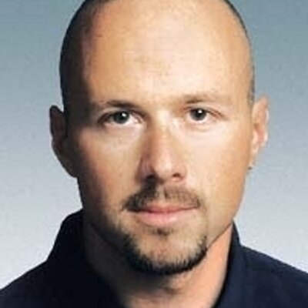
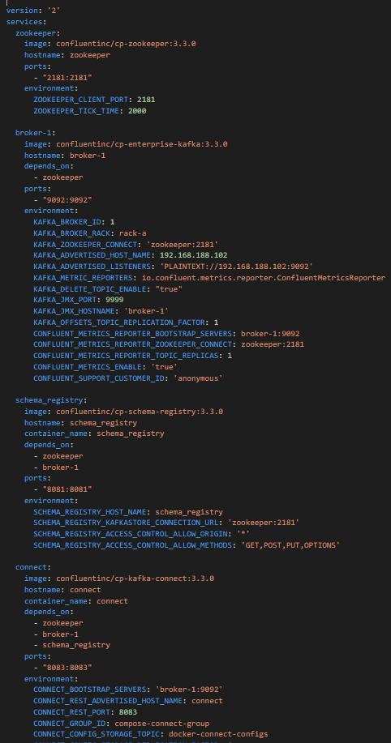
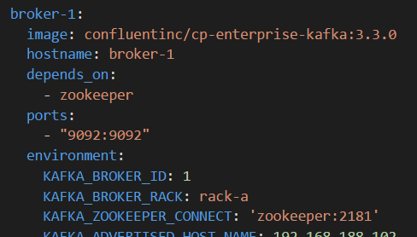
Setup for Oracle OpenWorld Demo What I received from Guido
Simple text file – 140 lines
Name of Docker image to run
Hostname on internal network between Docker containers
Dependency on other container (to start first)
Container port to expose externally
Environment variable to pass to container

Slide 23
Setup for Oracle OpenWorld Demo What I created in a few minutes
9092
Kafka Broker
8084
2181
Kafka
Rest Proxy
Zookeeper
8081
Kafka
Schema Registry
8083
8001
Kafka
Connect
Kafka Connect UI
9000
8002
Kafka Manager
Kafka
Schema Registry UI

Slide 24

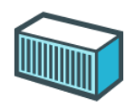
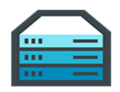
Some Quick Conclusions
Docker provides a great way to
Build environments (application & platform) (from simple, text based build files & public images)
Share & Ship these environments (either through build files or through ready-to-run images)
Run environments making efficient use of physical resources (that can be complex and have complex interdependencies)
And Guido is a very nice guy
And also:
[Docker] Containers are pivotal in cloud native environments, microservices architecture, DevOps and CD
Any IT professional should know her or his way around containers

Slide 25
Wait. What’s wrong with VMs?
Nothing as such.
VMs
Not as standardized
Not as quick to start up & scale up
Not as lean and mean (in size and in agility and in automation)
Not as generally accepted & adopted
Note:
Containers can run inside VM (and inside containers)
VMs provide more isolation
and support different OS for host and client system

Slide 26
Linux essentials
Applications share resources
Memory
Network interface
IP address
Ports
Users & groups
Environment Variables
Packages
Services
Application A
CPUs
Application B
Application C
Disk Storage

Slide 27
Linux essentials: Control Groups and Namespaces
Compartmentalize Resources into isolated units
Memory
Network interface
IP address
Ports
Users & groups
Environment Variables
Packages
Services
Network interface
IP address
Ports
Users & groups
Environment Variables
Packages
Services
Network interface
IP address
Ports
Users & groups
Environment Variables
Packages
Services
CPUs
Network interface
IP address
Ports
Users & groups
Environment Variables
Packages
Services
Network interface
IP address
Ports
Users & groups
Environment Variables
Packages
Services
Disk Storage

Slide 28
Linux essentials: Control Groups and Namespaces
Expose units through mapped network ports
Memory
Network interface
IP address
Ports
Users & groups
Environment Variables
Packages
Services
Network interface
IP address
Ports
Users & groups
Environment Variables
Packages
Services
Network interface
IP address
Ports
Users & groups
Environment Variables
Packages
Services
CPUs
Network interface
IP address
Ports
Users & groups
Environment Variables
Packages
Services
Network interface
IP address
Ports
Users & groups
Environment Variables
Packages
Services
Disk Storage

Slide 29


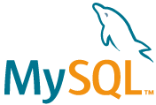
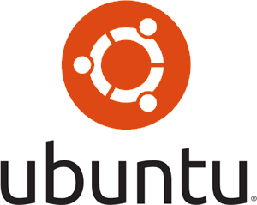
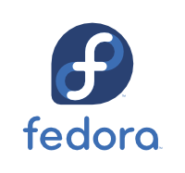
Linux essentials: Each unit runs its own processes
Units run their own processes:
OS (Linux)
Platform
Application
Memory
Network interface
IP address
Ports
Users & groups
Environment Variables
Packages
Services
Application A
Network interface
IP address
Ports
Users & groups
Environment Variables
Packages
Services
Application B
CPUs
Network interface
IP address
Ports
Users & groups
Environment Variables
Packages
Services
Application C
Network interface
IP address
Ports
Users & groups
Environment Variables
Packages
Services
Network interface
IP address
Ports
Users & groups
Environment Variables
Packages
Services
Disk Storage

Slide 30

This stuff is complex
Core Linux features were hard to use
Memory
Network interface
IP address
Ports
Users & groups
Environment Variables
Packages
Services
Application A
Network interface
IP address
Ports
Users & groups
Environment Variables
Packages
Services
Application B
CPUs
Network interface
IP address
Ports
Users & groups
Environment Variables
Packages
Services
Application C
Network interface
IP address
Ports
Users & groups
Environment Variables
Packages
Services
Network interface
IP address
Ports
Users & groups
Environment Variables
Packages
Services
Disk Storage

Slide 31
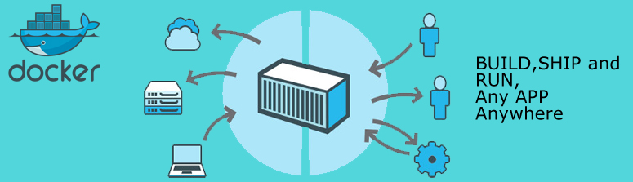
Docker has democratized Linux Containers
Container Image – a serialized file from which we can instantiate a container
Container Build script and workflow – to automate the creation of a container (image) using straightforward vocabulary
Engine – runtime platform for instantiating, running and managing containers, volumes and networks (REST API and CLI)
Docker Registry – Repository for Container Images
Memory
Network interface
IP address
Ports
Users & groups
Environment Variables
Packages
Services
Application A
Network interface
IP address
Ports
Users & groups
Environment Variables
Packages
Services
Application B
CPUs
Network interface
IP address
Ports
Users & groups
Environment Variables
Packages
Services
Application C
Network interface
IP address
Ports
Users & groups
Environment Variables
Packages
Services
Network interface
IP address
Ports
Users & groups
Environment Variables
Packages
Services
Disk Storage

Slide 32


Running Containers using Docker
Docker Hub
Create Container(s) from Image plus:
Port mapping
Volume
Environment Variable
(inter container) Network
Startup script
Memory
Network interface
IP address
Ports
Users & groups
Environment Variables
Packages
Services
Application A
Network interface
IP address
Ports
Users & groups
Environment Variables
Packages
Services
Application B
CPUs
Application C
Network interface
IP address
Ports
Users & groups
Environment Variables
Packages
Services
Network interface
IP address
Ports
Users & groups
Environment Variables
Packages
Services
Docker Engine
Disk Storage

Slide 33
Run container image on Docker host
Running Docker Containers

Slide 34
Running Containers using Docker
Docker Hub
Application A
docker run -d
--name ApplicationA
amis/NodeAppA:latest
amis/NodeAppA:1.4
Application A
ApplicationA
Docker Engine

Slide 35
Running Containers using Docker
Docker Hub
Application A
docker run -d
--name ApplicationA
-p 8010:8080 -p 8011:1521
--network=myBridgeNW
-e APP_HOME=/home/apps/applicationA -e PARAM1=value1
amis/NodeAppA:latest
amis/NodeAppA:1.4
8010
8080
8011
1521
Application A
APP_HOME= /home/apps/applicationA
ApplicationA
PARAM1=value1
Docker Engine

Slide 36
Running Containers using Docker
Docker Hub
Application A
docker run -d
--name ApplicationA
-p 8010:8080 -p 8011:1521
-v /host_files:/tmp/files
-e APP_HOME=/home/apps/applicationA -e PARAM1=value1
amis/NodeAppA:latest
amis/NodeAppA:1.4
8010
8080
8011
1521
Application A
$APP_HOME= /home/apps/applicationA
ApplicationA
$PARAM= value1
/tmp/files
Docker Engine
Disk Storage
/host_files

Slide 37
Demo Running Containers – Round One

Slide 38
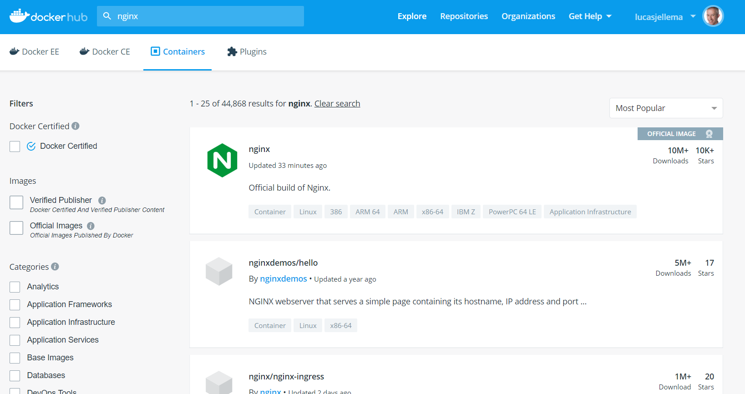
Run NGINX on your local (or any) Linux Host

Slide 39

Run NGINX Container using Docker
Docker Hub
nginx
nginx:1.17.1
docker run –d -p 8080:80 -e MY_SPECIAL_VAR='a great new day' --name mynginx nginx
Docker Engine

Slide 40
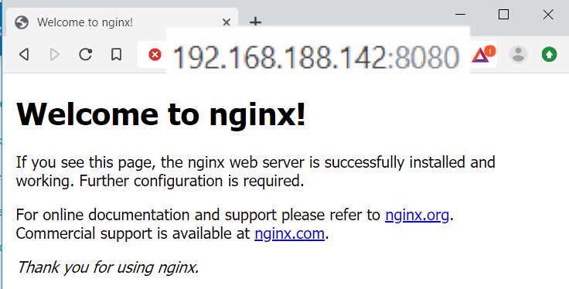
Docker Hub
nginx
nginx:1.17.1
8080
80
docker run –d -p 8080:80 -e MY_SPECIAL_VAR='a great new day' --name mynginx nginx
mynginx
nginx
MY_SPECIAL_VAR= a great new day
Docker Engine

Slide 41
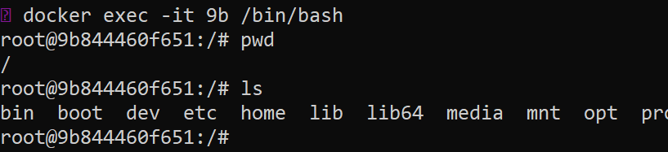
Docker Hub
nginx
nginx:1.17.1
8080
80
mynginx
nginx
docker run –d -p 8080:80 -e MY_SPECIAL_VAR='a great new day' --name mynginx nginx
MY_SPECIAL_VAR= a great new day
docker exec -it mynginx /bin/bash
Docker Engine

Slide 42
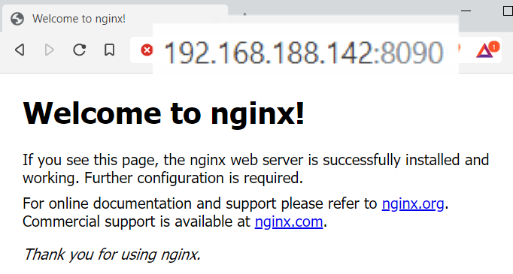
Docker Hub
nginx
nginx:1.17.1
8080
80
mynginx
MY_SPECIAL_VAR= a great new day
nginx
docker run -d -p 8090:80 --name mynginx2 nginx
8090
80
mynginx2
nginx
Docker Engine

Slide 43
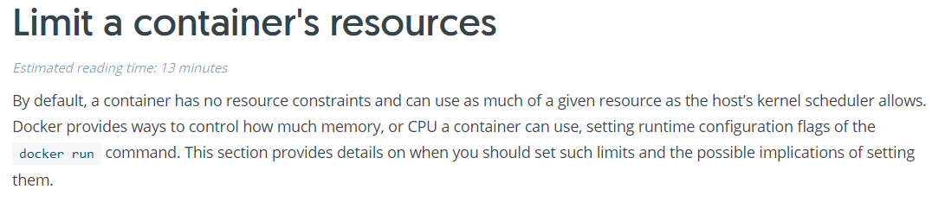
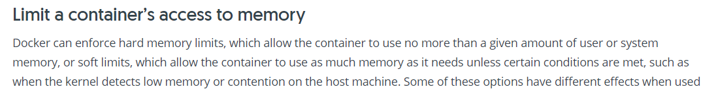
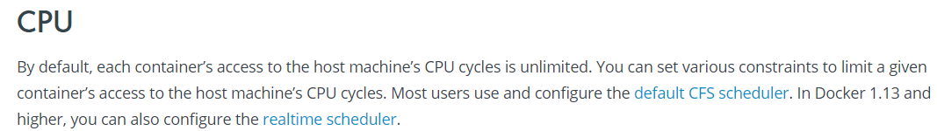
Docker Container Resources

Slide 44
Docker Container Resources
To restrict the amount of RAM memory available to a container, use –memory
By default, each container’s access to the host machine’s CPU cycles is unlimited. To restrict the CPU capacity, indicate how much of the available processor capacity a container can use with the flag cpu-shares – a container can be assigned a lower weight (“nice”) when CPU cycles are constrained and assigned to processes
docker run -it --memory=250m ubuntu /bin/bash
docker run -it --cpus=".5" --cpu-shares=1024 ubuntu /bin/bash

Slide 45
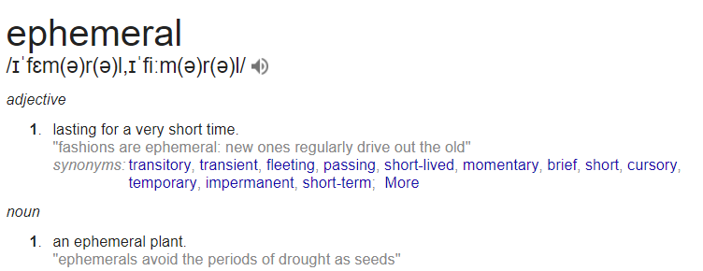
Containers are ephemeral (*
(* Candidate for IT word of the year 2017

Slide 46
Container state that needs to survive should be on an externally mapped volume
-v /u01/app/data:/data
Host Disk Volume
/u01/app/data

Slide 47
8080
80
mynginx
MY_SPECIAL_VAR= a great new day
nginx
8090
80
mynginx2
nginx
docker run --name mynginx3 -v /tmp:/usr/share/nginx/html:ro -d -p 8095:80 nginx
mynginx3
8095
80
nginx
/usr/share/nginx/html
Docker Engine
Disk Storage
/tmp

Slide 48
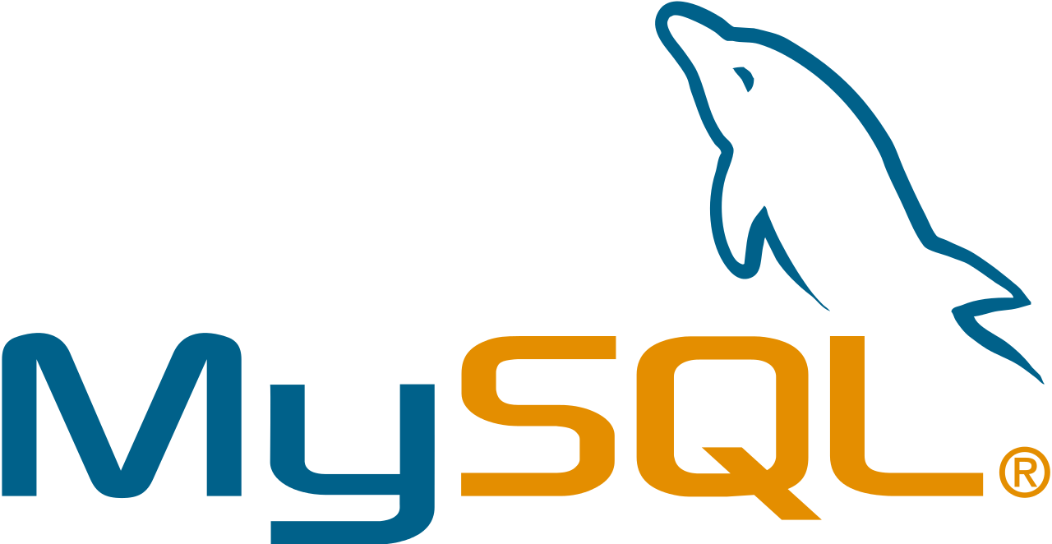

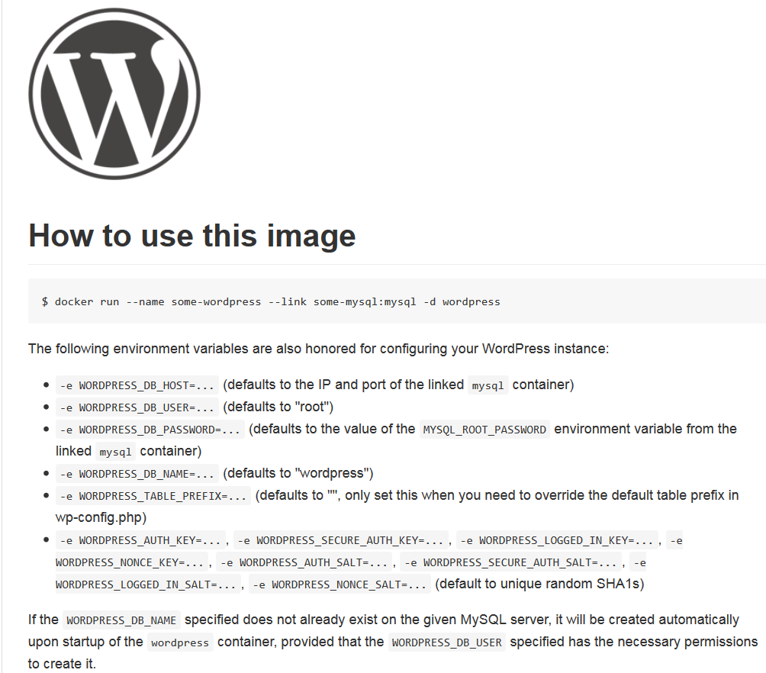
Implicit Docker Container Image Interface: environment variables, ports, volumes
Docker Hub
Parameters:
WORDPRESS_DB_PASSWORD, WORDPRESS_DB_USER, …
link mysql
Parameters:
MYSQL_DATABASE, MYSQL_ROOT_PASSWORD
Volume
..:/var/lib /mysql

Slide 49
docker volume create mysql-volume
docker network create wordpress-network
wordpress_network
wordpressdb
docker run --name wordpressdb --network='wordpress-network’ -v mysql-volume:/var/lib/mysql -e MYSQL_DATABASE=wordpressdb -e MYSQL_USER=wp-user -e MYSQL_PASSWORD=wp-password -e MYSQL_RANDOM_ROOT_PASSWORD=yes -d mysql:5.7
mysql
mysql_volume
Docker Volume
Docker Engine
Disk Storage

Slide 50
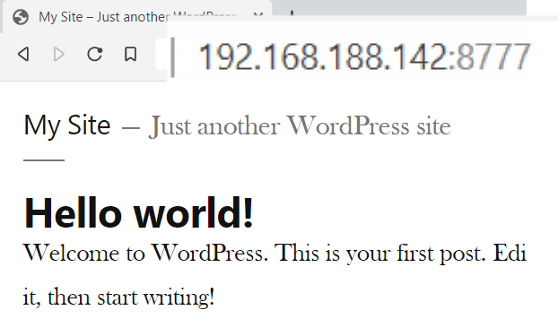
my-wordpress
8777
80
wordpress
wordpress_network
docker run --name my-wordpress --network wordpress-network -e WORDPRESS_DB_USER=wp-user -e WORDPRESS_DB_PASSWORD=wp-password -e WORDPRESS_DB_NAME=wordpressdb -e WORDPRESS_DB_HOST=wordpressdb -p 8777:80 -d wordpress
wordpressdb
mysql
mysql_volume
Docker Volume
Docker Engine
Disk Storage

Slide 51
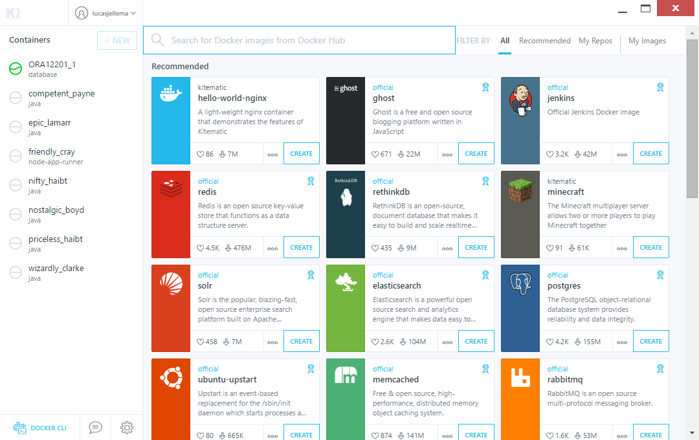
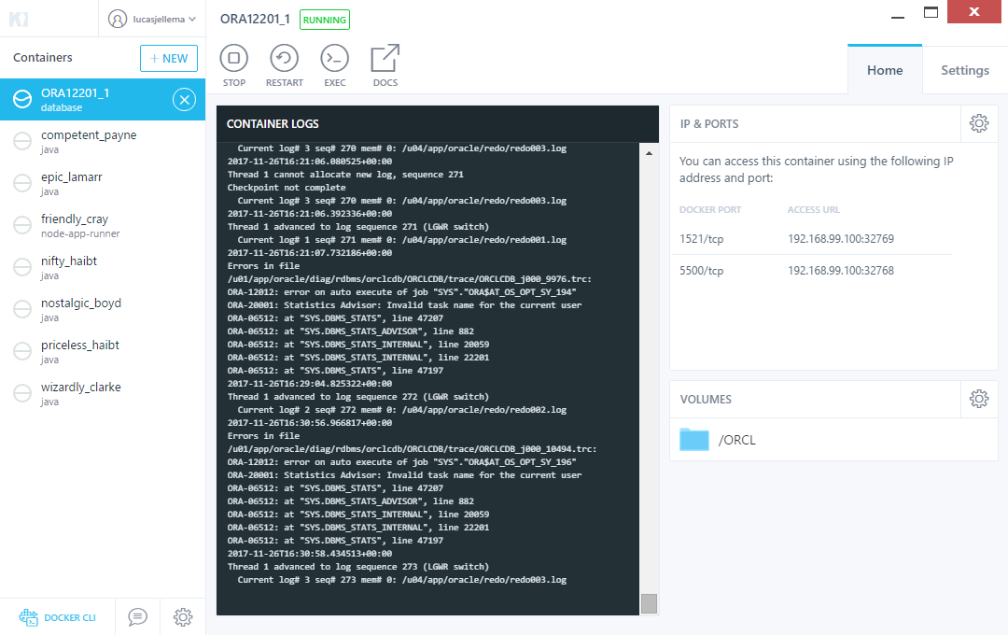
GUI tools for Managing Docker Runtime
Kitematic
Portainer.io
Simple Docker UI
DockStation
Shipyard
MicroBadger
Foxy
Data Pulley
Notes:
https://github.com/davidholiday/foxy
https://blog.codeship.com/docker-guis/

Slide 52
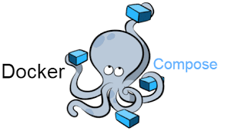
Docker Compose
Run collections of containers that collaborate and hang together
Start and stop all – in right order
Creates private network for containers in project
Reuse containers across runs
Until definition has changed

Slide 53
Setup for Oracle OpenWorld Demo What I received from Guido
Simple text file – 140 lines

Slide 54
Setup for Oracle OpenWorld Demo What I created in a few minutes
9092
Kafka Broker
8084
2181
Kafka
Rest Proxy
Zookeeper
8081
Kafka
Schema Registry
8083
8001
Kafka
Connect
Kafka Connect UI
9000
8002
Kafka Manager
Kafka
Schema Registry UI

Slide 55
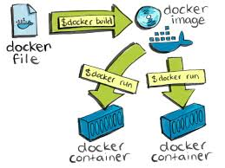
Create a runnable Docker Container image
Building Docker Container Images

Slide 56
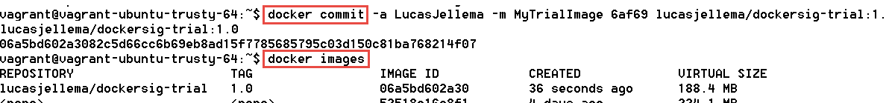
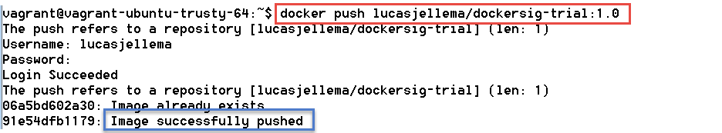
Building container images
Docker Hub
Dockersig-trial:1.0
Manual:
Run a container
Perform all installation and configuration
Commit the container and tag as new Container Image
Push Image to Registry to reuse

Slide 57

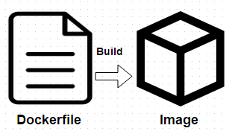
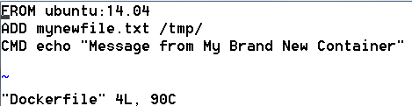
Building container images
Docker Hub
Dockersig-trial:1.0
Scripted (automated & repeatable/evolvable):
Create Docker Build file
Select base image
Gather files required during build
Consider multistage build
To purge intermediate artifacts
Build and Commit Image
Commit build file to Git
Push Image to Registry

Slide 58
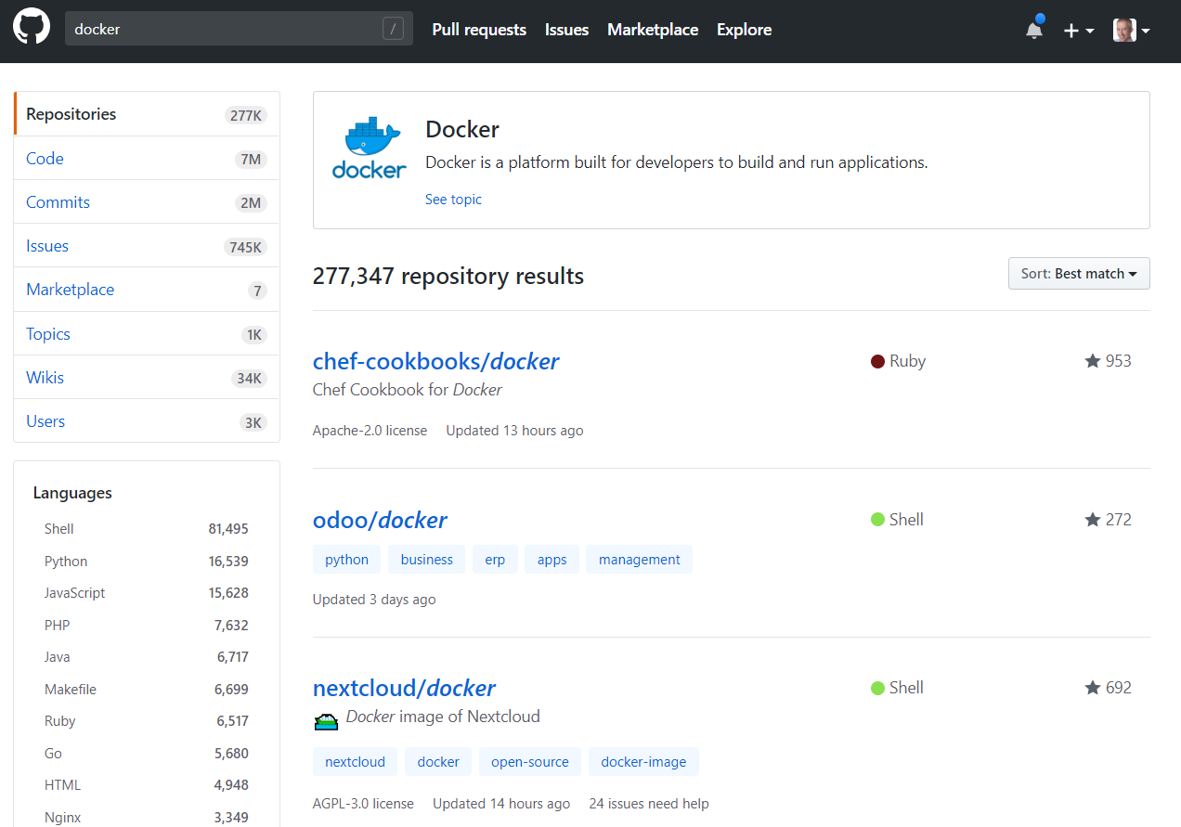
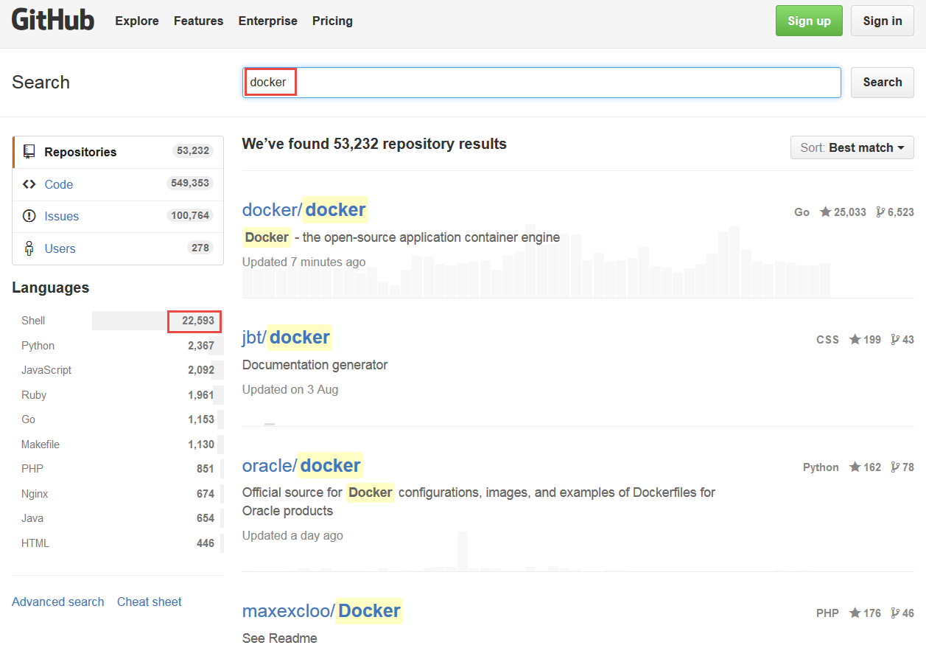
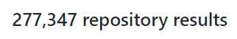
Docker Build Files on GitHub
Summer 2018

Slide 59
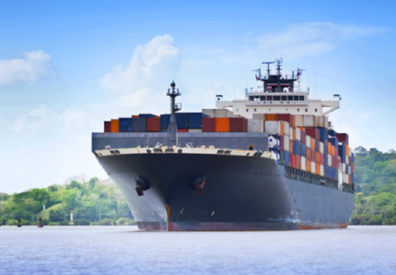
Distribute Docker Container images using Container Registry and more
Shipping Docker Container Images

Slide 60

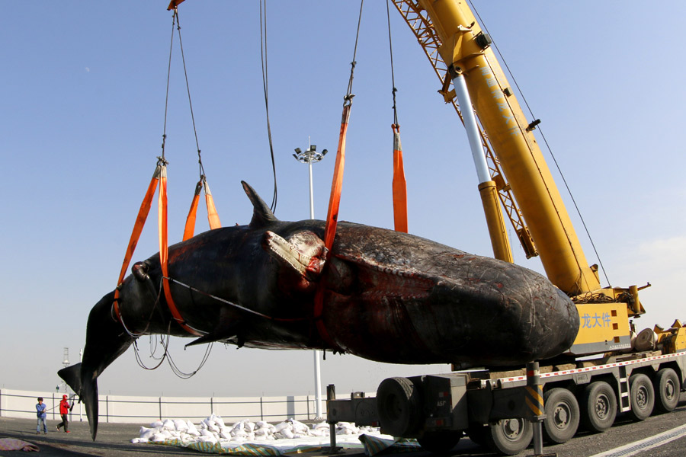
Do not share container image – share container build file!

Slide 61
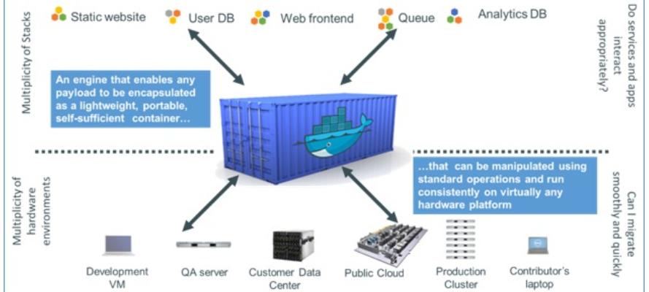
Ship (Container Images)
Package, Distribute, Share, Publish and Consume container images
The frozen state of a container (committed after building and further manipulating)
With everything needed to run the micro service: application and underlying platform & OS, ready to run on any Docker Engine anywhere
With an implicit interface (environment variables, ports, volume)

Slide 62
Docker Image Registry
Public Docker Registry
Docker Hub
push
pull &run
Private Docker Registry
Docker Hub
push
pull &run

Slide 63
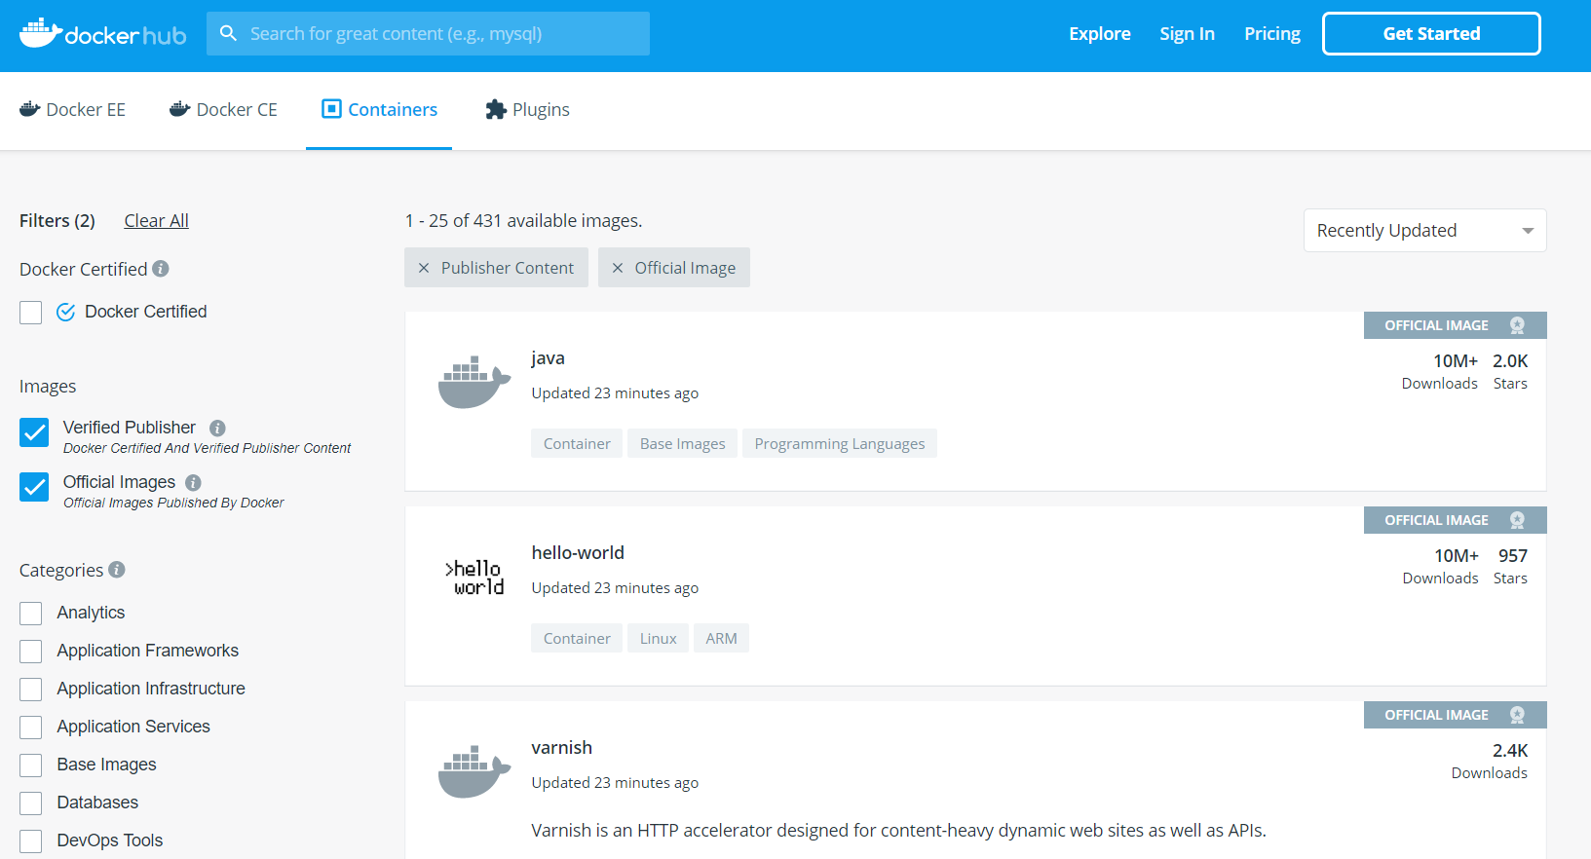
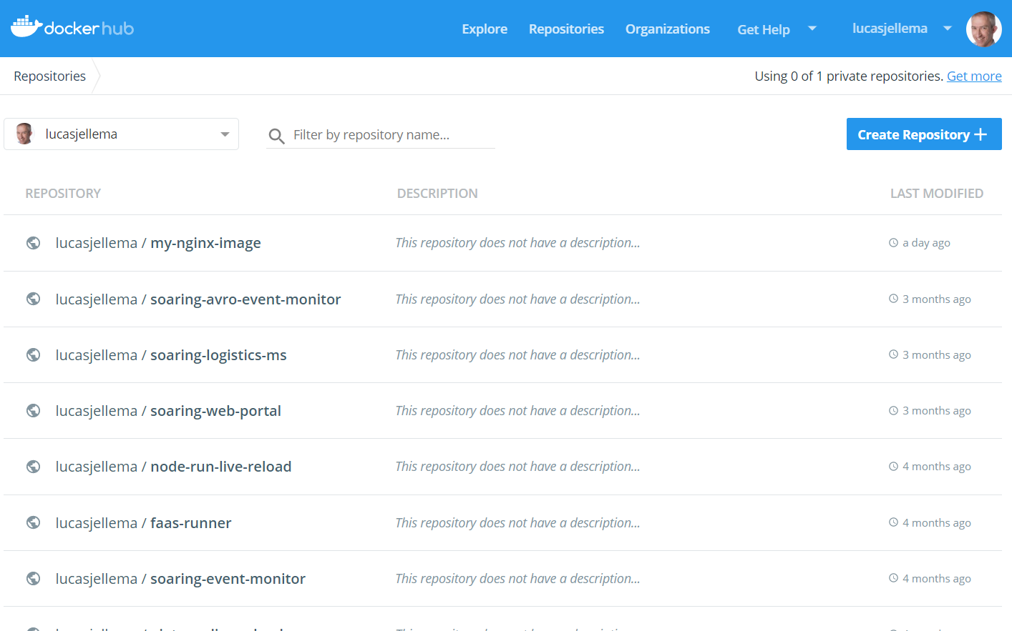
Docker Hub – most prominent Docker Container Image Registry
For anyone’s container images
Similar to GitHub – public and private repositories

Slide 64
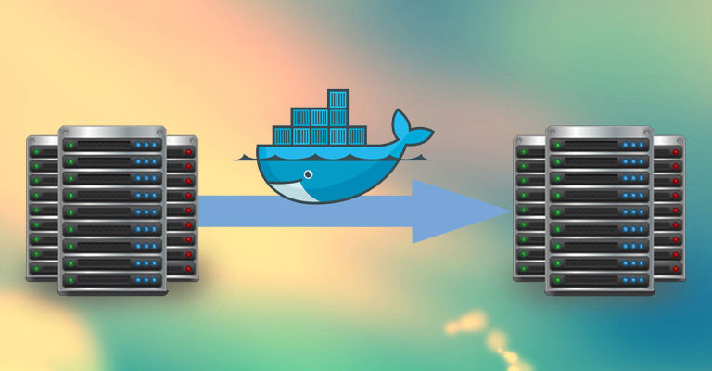
Shipping Container Images
Containers can be Exported and Imported
Via TAR-files
Images can be Saved and Loaded
Via TAR-files

Slide 65
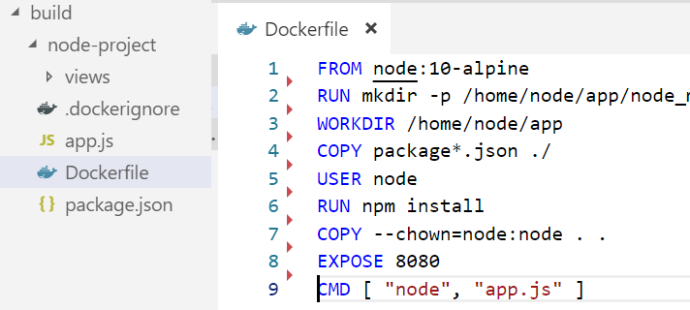
Demo Build Container Image
docker build -t nodejs-image-demo .

Slide 66
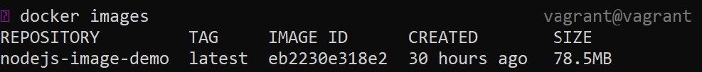
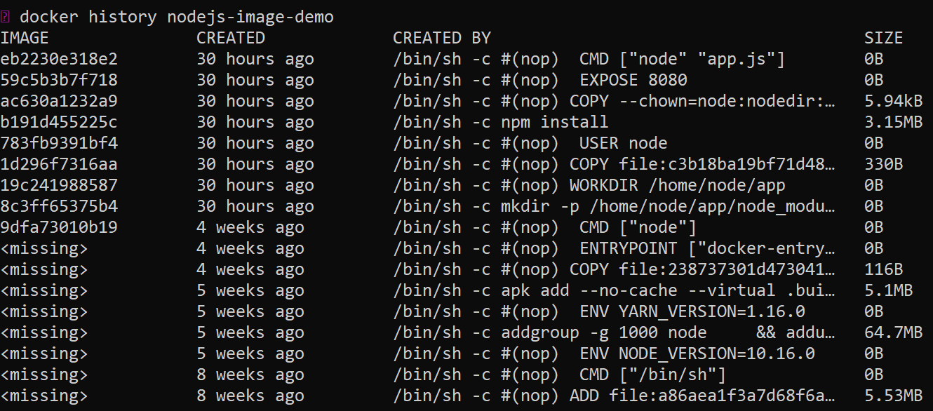
Demo Build Container Image
docker images
docker history nodejs-image-demo

Slide 67

my-node-app1
8300
8080
nodejs-image-demo
docker run --name my-node-app1 -p 8300:8080 -d nodejs-image-demo
my-node-app2
8301
8080
docker run --name my-node-app2 -p 8301:8080 -d nodejs-image-demo
nodejs-image-demo
Docker Engine

Slide 68
Tag and Push Image to Registry Shared and available to all
Docker Hub
nodejs-image-demo
lucasjellema/sharks-app:1.0
lucasjellema/sharks-app:1.0
docker tag nodejs-image-demo lucasjellema/sharks-app:1.0
docker push lucasjellema/sharks-app:1.0
AMIS SIG Introduction Docker & Kubernetes

Slide 69
Leveraging Containers on the Oracle workfloor
Container Use Cases for Oracle Professionals

Slide 70
Container Use Cases for Oracle professionals
R&D (aka Play) – try out technology
Quickly, easily, cleanly
Complex, multi-node configurations
Leverage huge number of resources available out in the open
Prepare and Share (running) environments for
Playing, Training, Testing, Beta-testing,
Deploy and Run application on generic cloud infrastructure
Especially ephemeral (stateless) and dynamically scalable
Streamlined CD across Development, Test and Production
Prepare for Cloud (consolidate, lift & shift workloads)
Analysis & What If Scenarios
Clone an environment, spin up, investigate, tear down & quit
Automated Testing
Against rich dataset with minimum set up and tear down
Microservices – implement, deploy and run

Slide 71
Oracle and Docker
Support Oracle products running on Docker
Provide scripts to build Docker Container Image with Oracle product
Provide ready to run Docker Container Images for Oracle products
Provide Docker infrastructure on OCI
Oracle Container Registry
For Oracle images and for customer images
Oracle Container Cloud
Now labeled as Classic
Container Pipelines (for CI/CD) (pka Oracle Wercker)
Container Platform (aka K8S)

Slide 72

Oracle Docker Build Files GitHub Repo
Building Docker containers with Oracle products
Notes:
https://github.com/oracle/docker-images

Slide 73



Example of Docker File
Build a Docker Container with Java 8 Runtime

Slide 74

Build Docker Container for Oracle Database 19.3 Enterprise Edition
Download database installation binaries before building the container

Slide 75

Why run Oracle Database on Docker?
Because we can…
Automated testing
Clone environments
Similar to PDB cloning
Quick provisioning of new environments
R&D
Production workloads?
Automated Ops/DBA => Autonomous Database (?)

Slide 76

Running WebLogic Server in Docker Containers - when and why?
Notes:
WLS Roadmap – CON6474 Oracle OpenWorld 2017

Slide 77

Notes:
Migrate WebLogic to Containers – OOW2017

Slide 78

Oracle Container Registry
Running containers from prebuilt images
Notes:
https://container-registry.oracle.com

Slide 79


Slide 80


Run Oracle Database from official Container Image
docker run -d -it –-name ORA12201_1 –P container-registry.oracle.com/database/enterprise:12.2.0.1

Slide 81




WebLogic in Oracle Container Registry

Slide 82

Oracle Cloud Infrastructure Container Registry – for customer images

Slide 83


OCI - Oracle Container Registry for Your Images
After build and before run – container images need to be stored
Secure (because runtime artefacts)
Accessible (& low latency) to deployment engine and container runtime
Scalable and Smart (no duplicate images and image layers)

